Slide 1
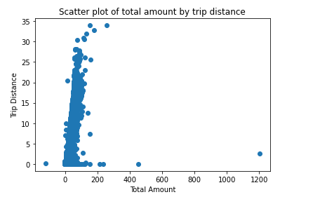
Ecploratory Data Analysis of New York City TLC
Executive Summary by Automatidata
Project Overview
In this project New York City TLC has consulted with Automatidata to prepare a regression model that can predict taxi fares beforehand. In Course 3 of this Google Advanced Data Analytics course, an EDA has been carried out in which data is cleaned, structured, and visualised.
Some outliers reported in the data are as follows: -
Total amount goes negative and zero which should be removed as an incorrect entry
Tip reached a maximum of 200 $ which was unusual and an outlier which needs investigation.
Trip distance of 0 which should be removed via some algorithmic advancements
Total amount near to 1200 while the trip distance was in the range of 0-5.
Total amount being negative which can be removed as it is of less proportion that is 14 rows out of 22699 rows i.e. 0.06%.
Other key insights: -
The data was sorted out in ascending order of their drop off location
The highest ride count was in the month of Mayand the day of Thursday.
Some algorithmic manipulations for removing outliers which were reported in EDA.
Determine variables where trip fares can be affected.
Consider the most relevant key variables for regression modelling

